Slide 1

Healthcare chatbot
TEAM MEMBERS
BUCHINGARI VASU[RA2011003010412]
CHANDRA SEKHAR.K[RA2011003010435]
SHAIK HUSSAIN AHAMED[RA2011003010439]

Slide 2
ABSTRACT
This project involves the development of a healthcare chatbot that utilizes artificial intelligence to assist users in managing their healthcare needs. The chatbot provides personalized recommendations and advice based on the user's symptoms, medical history, and lifestyle. The chatbot also has the capability to schedule appointments, order prescription refills, and provide reminders for medication and appointments. The project aims to improve accessibility to healthcare services, reduce the burden on healthcare providers, and improve the overall quality of care. The chatbot is designed to be user-friendly, interactive, and secure to ensure confidentiality of user information. This project has the potential to revolutionize healthcare delivery by utilizing AI to provide personalized and efficient healthcare services.

Slide 3
LITERATURE SURVEY

Slide 4
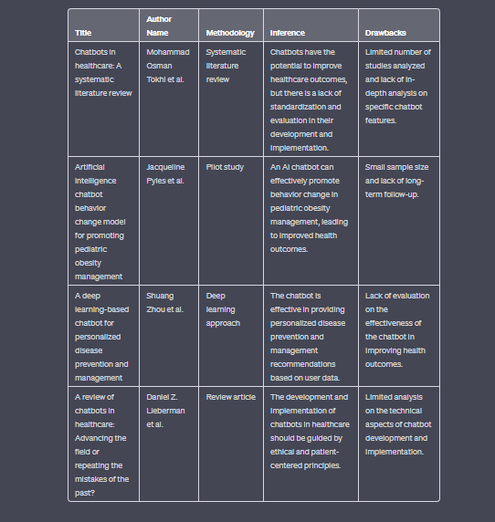

Slide 5
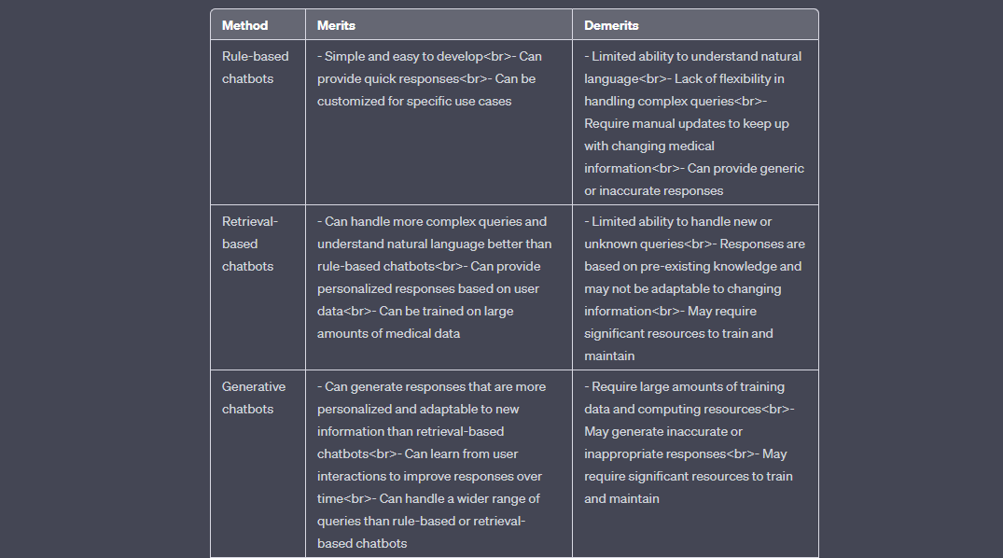
Comparison of Existing methods with merits and demerits

Slide 6
Challenges to address
Data privacy and security: Healthcare chatbots deal with sensitive information about patients' health and medical history, which makes data privacy and security a top concern. Developers must ensure that user information is secure and protected from unauthorized access.
Quality of data: The accuracy and quality of data used to train the chatbot is critical for the success of the project. Healthcare data is often complex and may require specialized expertise to ensure it is labeled and pre-processed appropriately.
Lack of standardization: There is a lack of standardization in the development and evaluation of healthcare chatbots. Developers must ensure that their chatbot follows best practices and guidelines in the field, and evaluate its effectiveness in improving patient outcomes.
Trust and transparency: Patients need to trust the chatbot in order to use it effectively. Developers must ensure that the chatbot is transparent in its decision-making process and is able to explain its recommendations to patients in a way they can understand.

Slide 7
Problem Statement and Objectives
Problem statement: Healthcare services can be expensive and inaccessible to a large number of people, leading to a lack of proper medical care and increased mortality rates. Moreover, patients may have to wait for long hours to consult doctors and healthcare professionals. In such cases, a healthcare chatbot can provide a cost-effective and accessible solution to deliver medical advice and care to patients.
Objectives: The main objective of the healthcare chatbot project is to develop an AI-powered chatbot that can provide personalized medical advice and care to patients, 24/7, without the need for them to visit a healthcare professional in person. The specific objectives of the project include:
Developing a chatbot that can understand natural language queries related to medical conditions and provide accurate and personalized responses based on the patient's symptoms and medical history.
Ensuring that the chatbot is user-friendly, easy to use, and accessible to all users, regardless of their language or ability.
Integrating the chatbot with existing healthcare systems, such as electronic health records, to ensure that patient information is secure and accurate.
Ensuring that the chatbot is compliant with data privacy and security regulations to protect patient information.

Slide 8
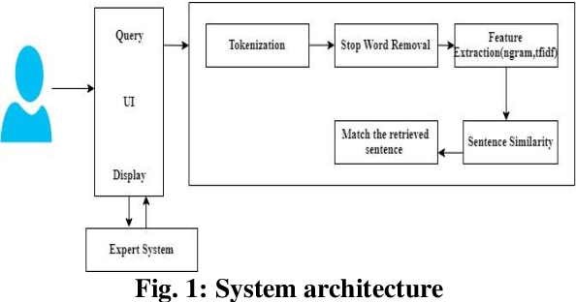
Architecture/Block Diagram of the Proposed model

Slide 9
Modules Description and Implementation
Natural Language Processing (NLP) module: This module is responsible for processing user queries and understanding the intent behind them. It uses machine learning algorithms to analyze user input and extract relevant information, such as symptoms and medical history.
Implementation: NLP algorithms such as LSTM, GRU or Transformers can be used to build this module. Libraries such as NLTK, SpaCy or HuggingFace's Transformers can be used to implement the algorithms.
Knowledge Base module: This module is responsible for storing medical knowledge and information, including symptoms, diseases, and treatments. The chatbot can query this module to provide accurate and up-to-date medical advice.
Implementation: A database management system such as MongoDB or MySQL can be used to store and retrieve information from the knowledge base.
User Interface module: This module is responsible for providing a user-friendly interface for patients to interact with the chatbot. It can be implemented as a web or mobile application, or integrated into an existing healthcare portal.
Implementation: Web development frameworks such as React or Angular can be used to build the user interface module.

Slide 10
References
[1] Mohammed Javed, P. Nagabhushan, B.B. Chaudhari, “A Direct Approach for Word and Character Segmentation in Run-Length Compressed Documents with an Application to Word Spotting”, 13th International Conference on Document Analysis and Recognition (ICDAR), 2015.
[2] Naeun Lee, Kirak Kim, Taeseon Yoon, “Implementation of Robot Journalism by Programming Custombot using Tokenization and Custom Tagging”, 2017.
[3] Tao Jiang, Hongzhi Yu, Yangkyi Jam, “Tibetan Word Segmentation Systems based on Conditional Random Fields”, 2011.
[4] Jerome r. Bellagarda, “Parts-Of-Speech tagging by Latent Analogy”, IEEE Journal of Selected Topics in Signal Processing, Vol. 4, No. 6, 2010.
[5] Liner Yang, Meishan Zhang, Yang Liu, Maosong Sun, Nan Yu, Guohong Fu, “Joint POS Tagging and Dependency Parsing with Transition-based Neural Networks”, 2018.

